Slide 1


Physics (PHY 102) Mechanics
Farjana Yeasmin
Lecturer in Physics, Basic Science Division
World University of Bangladesh, Dhaka-1205

Slide 2
Mechanics
Mechanics is the branch of Physics dealing with the study of motion when subjected to forces or displacements, and the subsequent effects of the bodies on their environment.
Motion
In physics, motion is the change in the position of an object with respect to its surroundings in a given interval of time. The motion of an object with some mass can be described in terms of the following:
Distance
Displacement
Speed
Velocity
Time
Acceleration

Slide 3
Newton’s laws of motion
1st Law: Every object will remain at rest or in uniform motion in a straight line unless compelled to change its state by the action of an external force.
1st Law gives us the idea of inertia.

Slide 4
Newton’s laws of motion
2nd Law: Newton's Second Law of Motion states that the rate of change of linear momentum of a body is directly proportional to the external force applied or F = ma, or net force is equal to mass times acceleration.

Slide 5

Newton’s laws of motion
3rd Law: For every action, there is an equal and opposite reaction.
Or we can say $F_{1}=−F_{2}$ , where $F_{1}$ and $F_{2}$ are two equal and opposite forces.

Slide 6

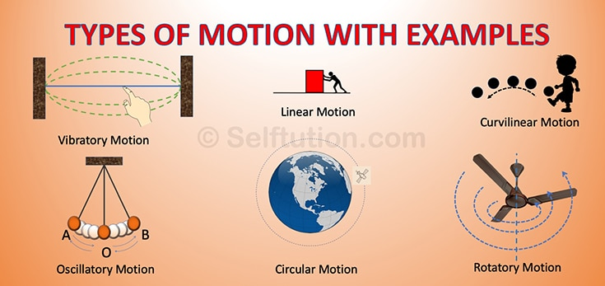

Slide 7
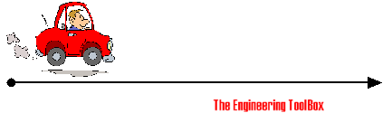
Linear Motion and Circular Motion.
Linear Motion
Linear motion involves an object moving from
one point to another in a straight line.
– Examples include a parade of soldiers, a train moving along a straight line
Circular Motion
Rotational motion involves an object rotating
about an axis.
– Examples include a merry-go-round, the rotating
earth, a spinning skater, a top, and a turning wheel.

Slide 8
Linear Motion

Slide 9
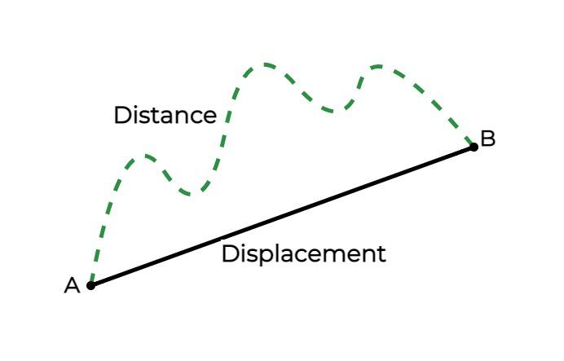
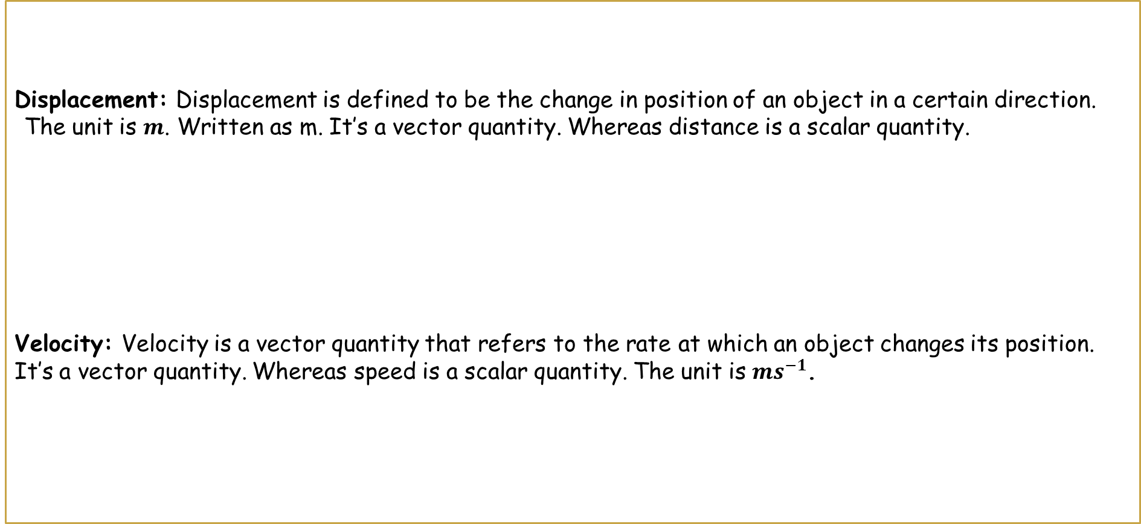
Displacement: Displacement is defined to be the change in position of an object in a certain direction.
The unit is $m$. Written as m. It’s a vector quantity. Whereas distance is a scalar quantity.
Velocity: Velocity is a vector quantity that refers to the rate at which an object changes its position. It’s a vector quantity. Whereas speed is a scalar quantity. The unit is $ms^{−1}$.

Slide 10

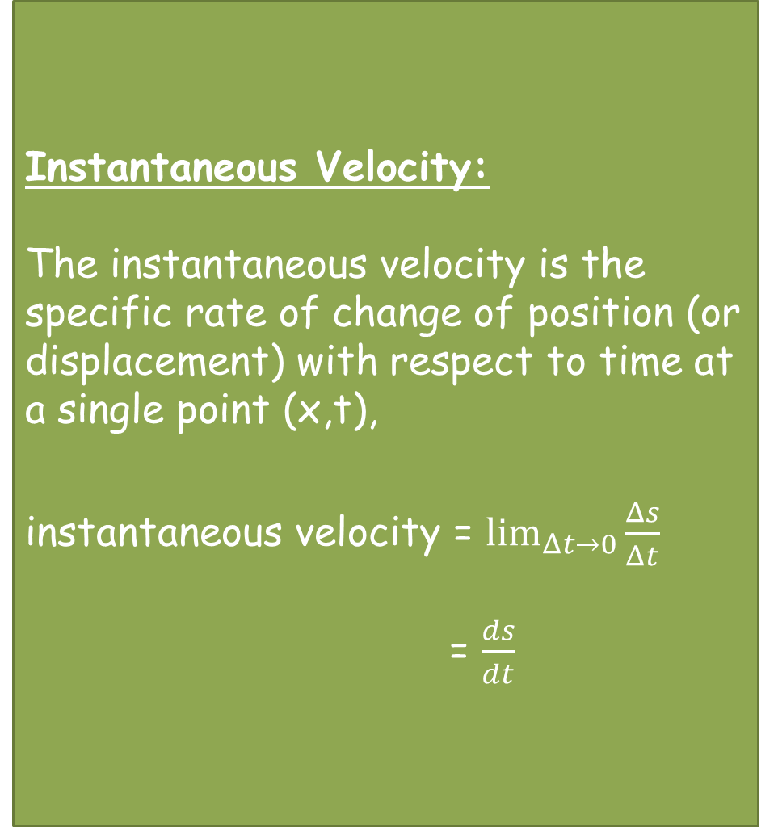
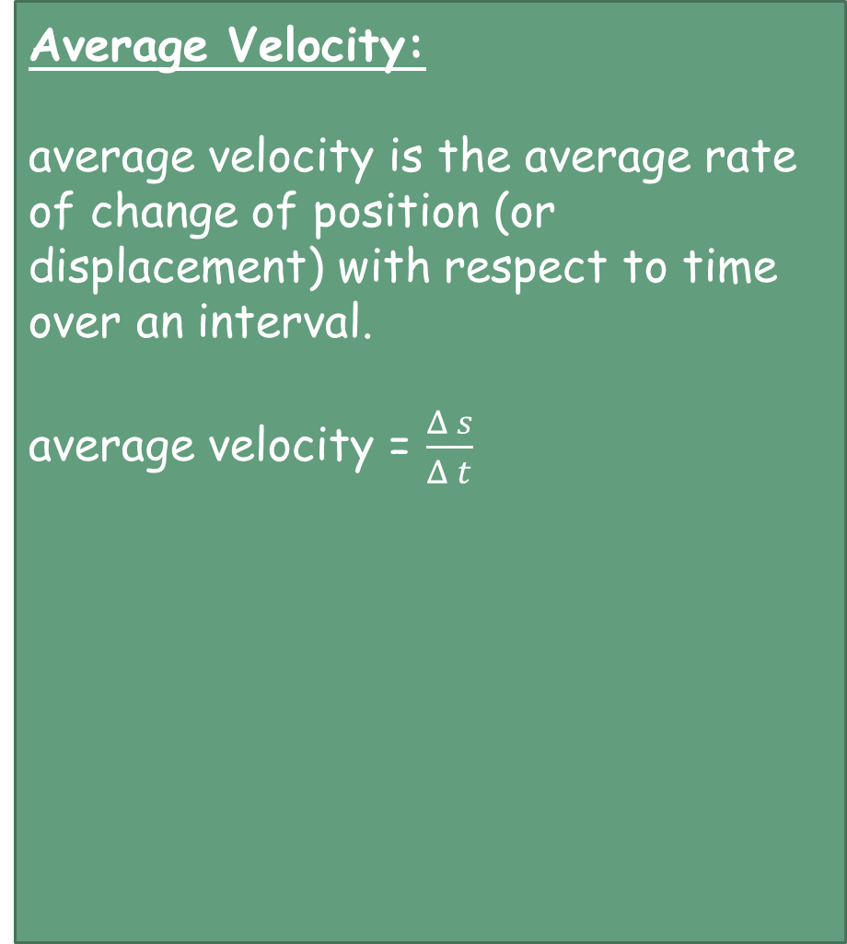
Average Velocity:
average velocity is the average rate of change of position (or displacement) with respect to time over an interval.
average velocity = $\frac{Δ s}{Δ t}$
Instantaneous Velocity:
The instantaneous velocity is the specific rate of change of position (or displacement) with respect to time at a single point (x,t),
instantaneous velocity = $\lim_{Δt→0}{{\frac{Δs}{Δt}}^{}}$
= $\frac{ds}{dt}$

Slide 11
Acceleration, a
Rate of change of velocity is called acceleration. The unit is $ms^{−2}$. The symbol is $a$.
Force, F
A force is a push or pull upon an object resulting from the object's interaction with another object. The unit is $N$ (newton). And the symbol is $F$. Where $F=ma$

Slide 12
Mass, m
The total amount of substance in a body is called it’s mass, $m.$ The unit is $kg.$
Momentum, p
The total amount of substance in a body $m$, multiplied by its velocity $v$ is called momentum. The symbol is $P=mv$

Slide 13
Circular Motion

Slide 14
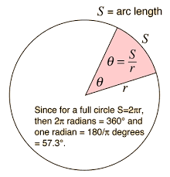
Angular Displacement
The angular displacement (θ) of a body in circular motion is defined as the change in angle ( θf−θi), in radians, of a body as it rotates around a circle. In mathematical terms, It is the ratio of distance traveled around a circle and the radius of the circle.

Slide 15
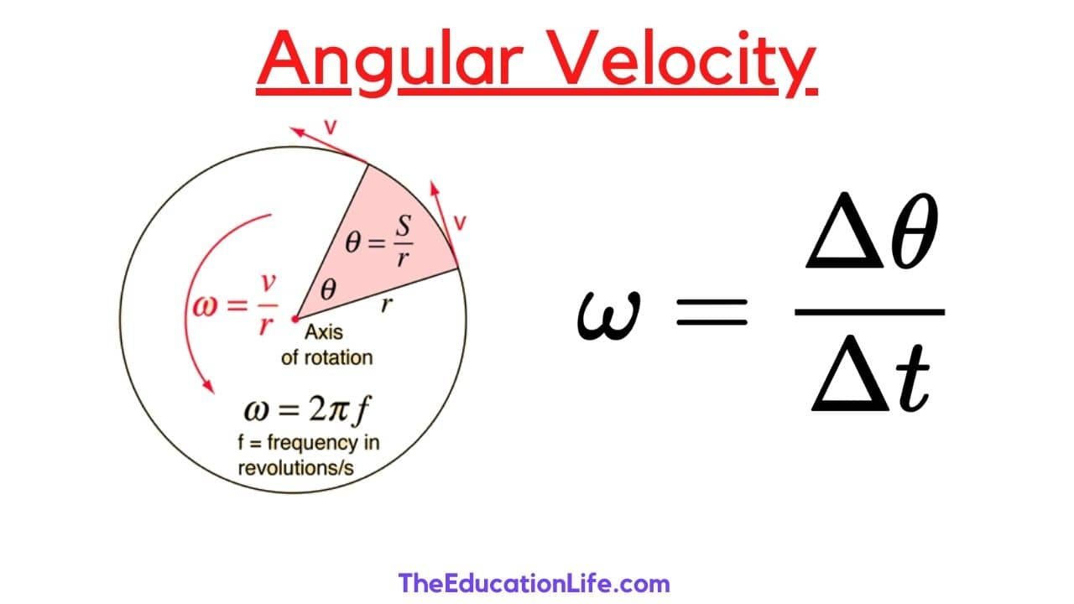
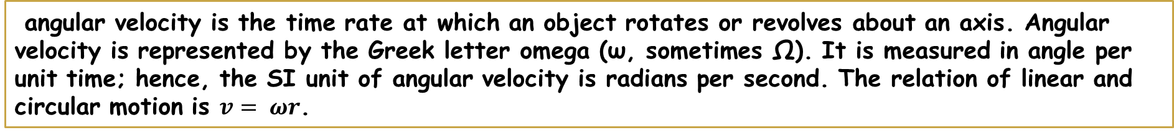
Angular Velocity
angular velocity is the time rate at which an object rotates or revolves about an axis. Angular velocity is represented by the Greek letter omega (ω, sometimes Ω). It is measured in angle per unit time; hence, the SI unit of angular velocity is radians per second. The relation of linear and circular motion is $v= ωr$.

Slide 16

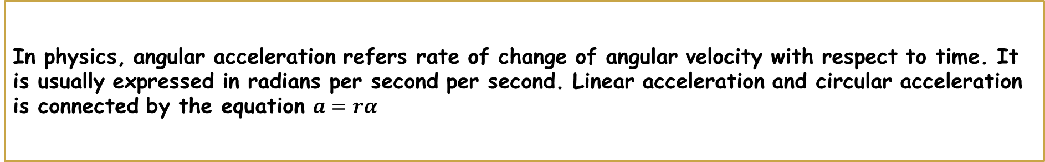
Angular Acceleration
In physics, angular acceleration refers rate of change of angular velocity with respect to time. It is usually expressed in radians per second per second. Linear acceleration and circular acceleration is connected by the equation $a=rα$

Slide 17
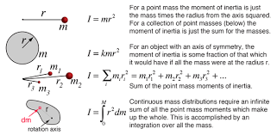
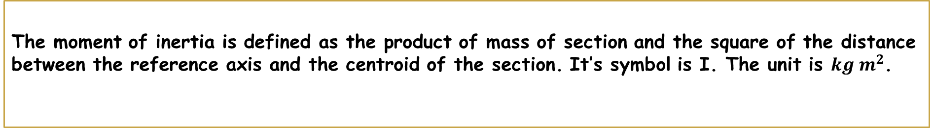
Moment of Intertia, I
The moment of inertia is defined as the product of mass of section and the square of the distance between the reference axis and the centroid of the section. It’s symbol is I. The unit is $kg m^{2}$.

Slide 18
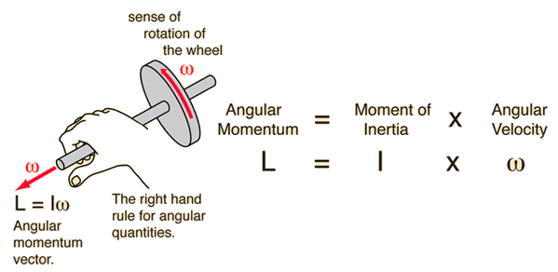
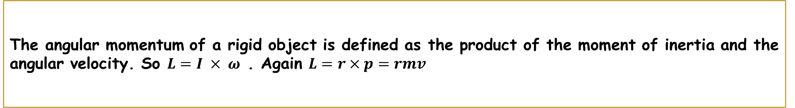
Angular Momentum, L
The angular momentum of a rigid object is defined as the product of the moment of inertia and the angular velocity. So $L=I × ω$ . Again $L=r×p=rmv$

Slide 19
Torque
Torque is a measure of the force that can cause an object to rotate about an axis. Just as force causes an object to accelerate in linear kinematics, torque causes an object to acquire angular acceleration. Torque is a vector quantity.

Slide 20
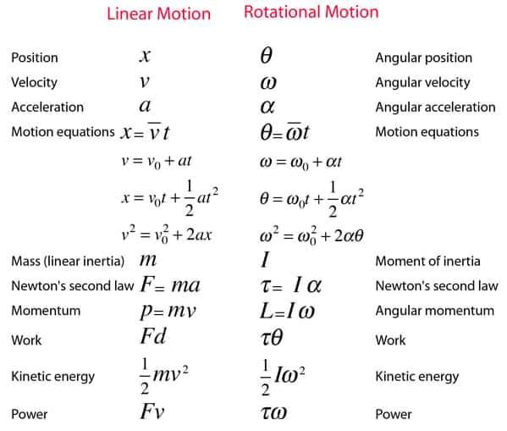

Slide 21
Conclusions
Thank you

